Slide 1

Department of Information Technology University of Gujrat
“Event Scheduling System”
Supervised by:
Miss Sabiqa Ashraf.
Presented by:
Muhammad Talha Tarar 16491556-013
Muhammad Hamza Javed 16491556-023
Ahmed Jamal 16491556-040

Slide 2
Introduction
Android application.
Manual Event organizing is a time consuming task.
Facilitate event organizer and client in their interaction.
Event organizer can provide its services to promote its business.
Client can get these services and hire event organizer for their events.
Location and rating based availability of event organizers and services.

Slide 3
Existing System
System | Limitation
Evento.com.pk | Specific organization. No android application. Complex Interface. Provide limited services related to event.
ShadiBox.com | Unable to directly interact with event organizer. No android application. No payment method.
Eventoxs.com | Specific organization. Limited services. No android application. No online payment method.

Slide 4
Problem Statement
There is currently no android application available for easy access.
Hectic process for event organizer and client to communicate.
Tiresome process of payment method.
Complex system interface for user interaction.
No recommendation for users.

Slide 5

Proposed Solution
Single Platform will be provided for customer and event organizer to directly interact with each other.
Help user to find the best place` for their event.
Help user to find services related to their event.
Help event organizer in their business decision.
Help event organizer to advertise their business.
Both event organizer and customer can use android application to perform their tasks.

Slide 6
Comparison
Features | Ebizpk | Shadibox | Evento.com.pk | Proposed System
Android application | No | No | No | Yes
Shared platform for event organizer and customer | No | Yes | No | Yes
Direct Communication | Yes | Yes | Yes | Yes
Organize event using system | No | Yes | Yes | Yes
Business management for event organizer | No | Yes | No | Yes
Can organize any type of event | Yes | No | No | Yes

Slide 7
Modules
Client
Sign In /Up for an account. View update about specific event. Organize any event Communicate with event organizers. Can search venues Can get services related to event. Check nearby places using google map. Order for any event. Get suggestions based on rating. Give feedback. Can pay through QR code.

Slide 8
Modules
Event Organizer
Manage its account. View, accept or delete orders. Update its portfolio to attract customers. Can analyze user interest. Can communicate with clients or others event organizers. Public calendar to manage orders.
Admin
Add/ delete user. Add / delete event organizer. Manage activities. Check statistics.

Slide 9
Scope
Goals: -
To overcome the problems in existing system and provide common platform both for user and event organizer.
Help users to easily organizer their events.
Help event organizer to easily manage and provide services to clients.
Objectives: -
Event Organizer and User can easily interact with each other.
Organizing and managing issues related to events can be resolved through this application.
Provide guidelines for using this application.
User can easily interact with application.

Slide 10
Non Functional Requirements :-
User-Friendly interface
Responsive
Secure
Performance oriented
More accurate

Slide 11
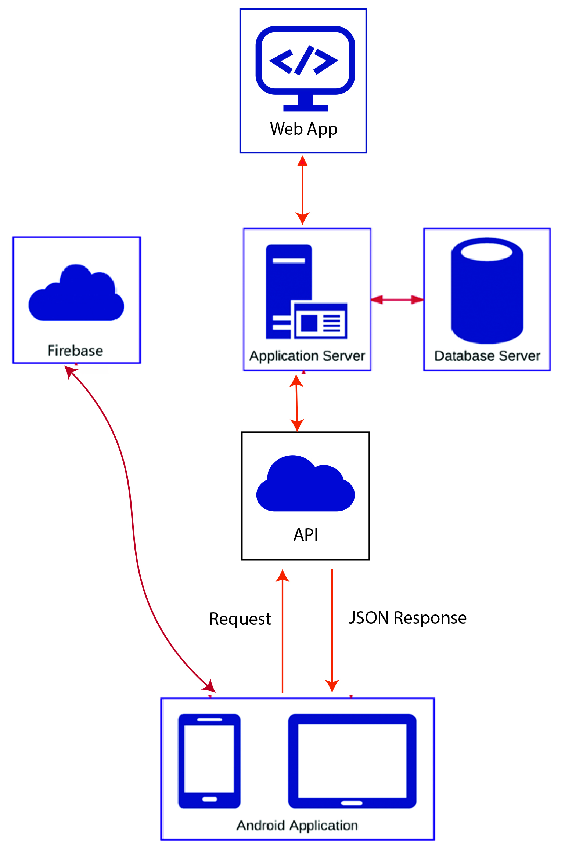
Architecture Diagram

Slide 12
Tools & Technology
Android Studio IDE(Platform)
Java (Language for android application development)
XML(For application layout)
MySQL(Main database platform)
Firebase(Secondary database and for cloud messaging)
HTML, CSS, Bootstrap(Construction and designing admin panel)
JavaScript, jQuery, AJAX,PHP(Language for web based admin panel)

Slide 13
Conclusion
Advantages:
To overcome the problems in existing system.
Time Saving.
Easy to use.
User friendly Interface.
Disadvantages:
Must have android phone.
Need internet connection.

Slide 14
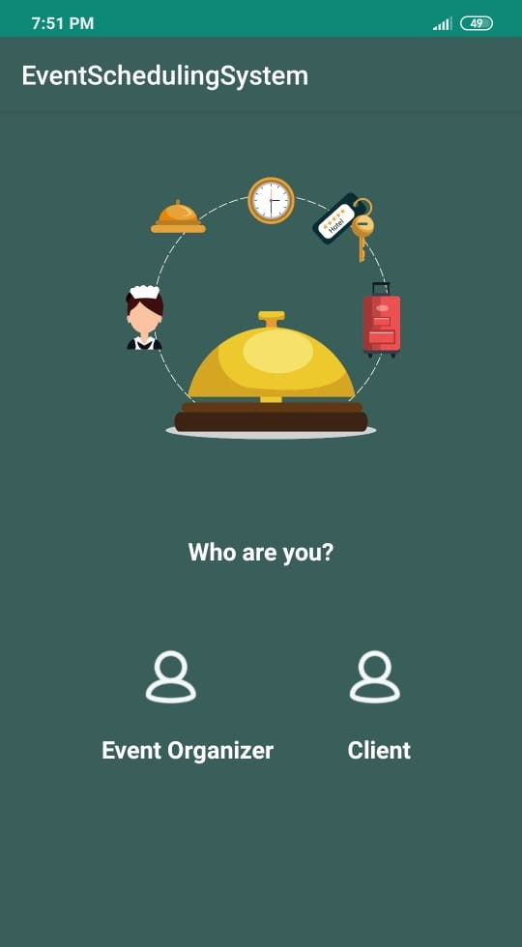
Prototype:
Home Screen Figure (1)

Slide 15
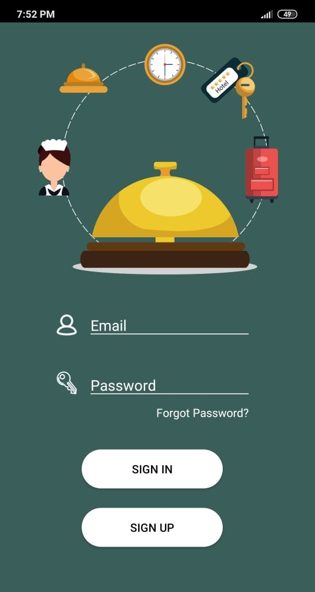
Continue…
Event Organizer Sign In/ Up Figure (2)

Slide 16
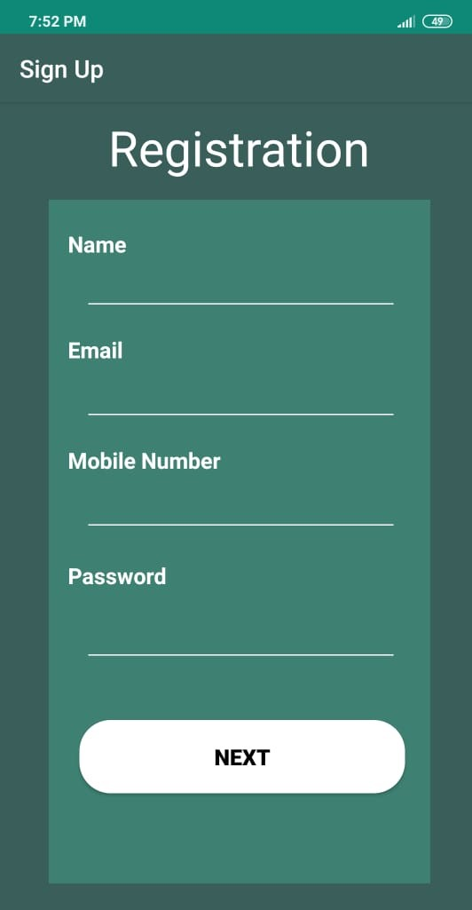
Continue…
Event Organizer Registration 1 Figure (3)

Slide 17
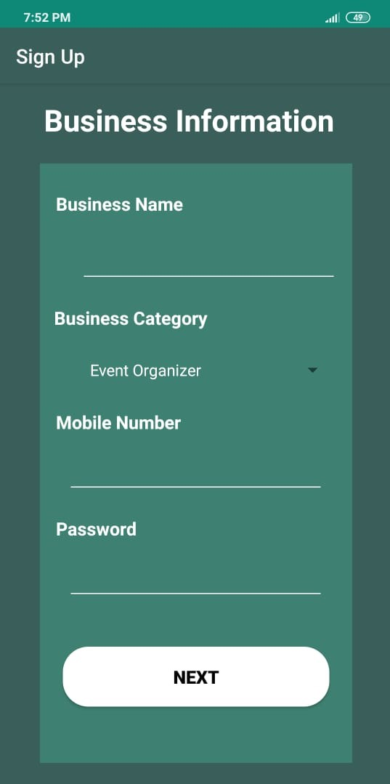
Continue…
Event Organizer Registration 2 Figure (4)

Slide 18
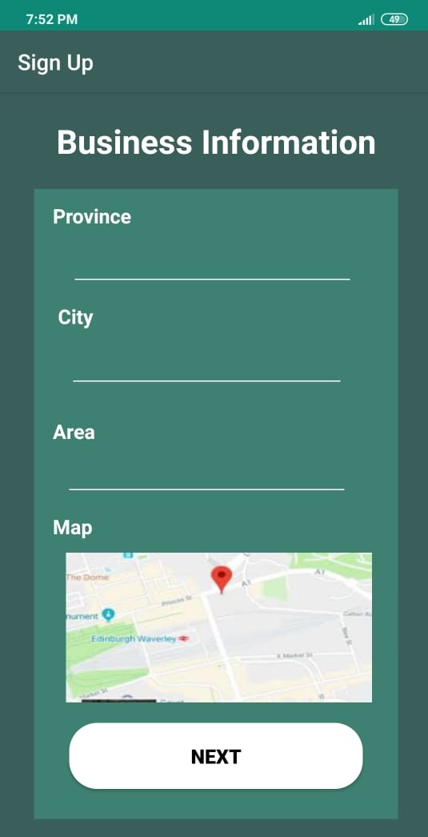
Continue…
Event Organizer Registration 3 Figure (5)

Slide 19
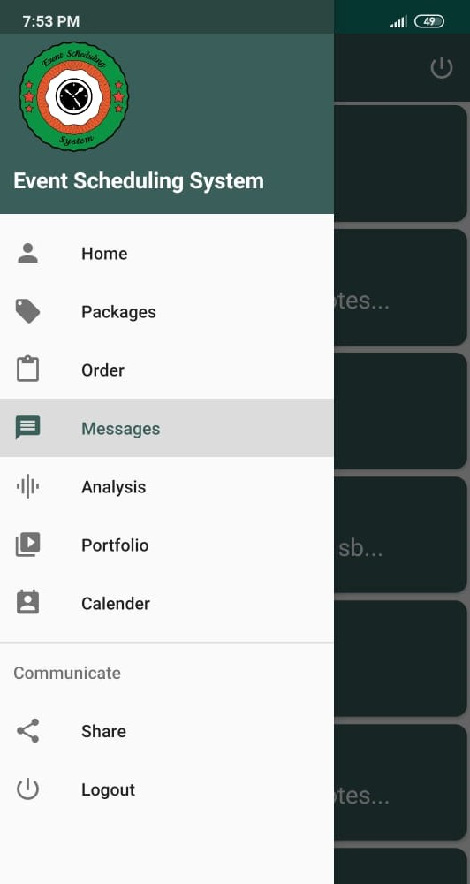
Continue…
Event Organizer Navigation Figure (6)

Slide 20
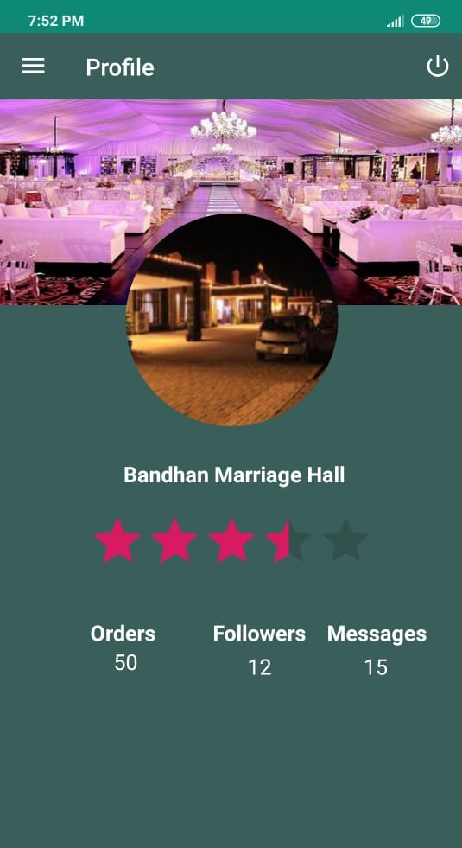
Continue…
Event Organizer Home Figure (7)

Slide 21
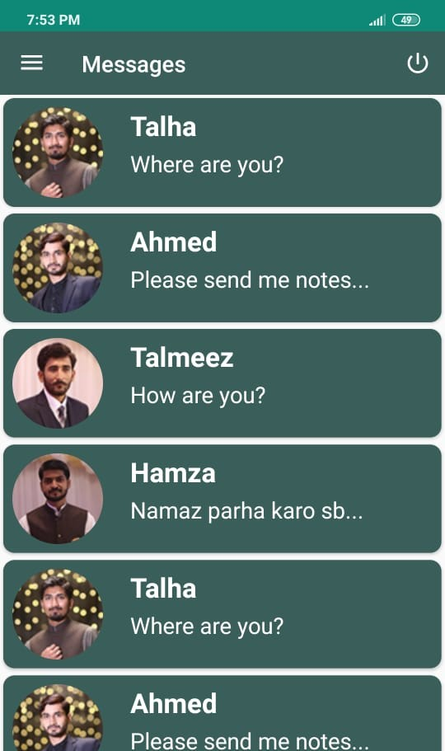
Continue…
Event Organizer Chat Figure (8)

Slide 22
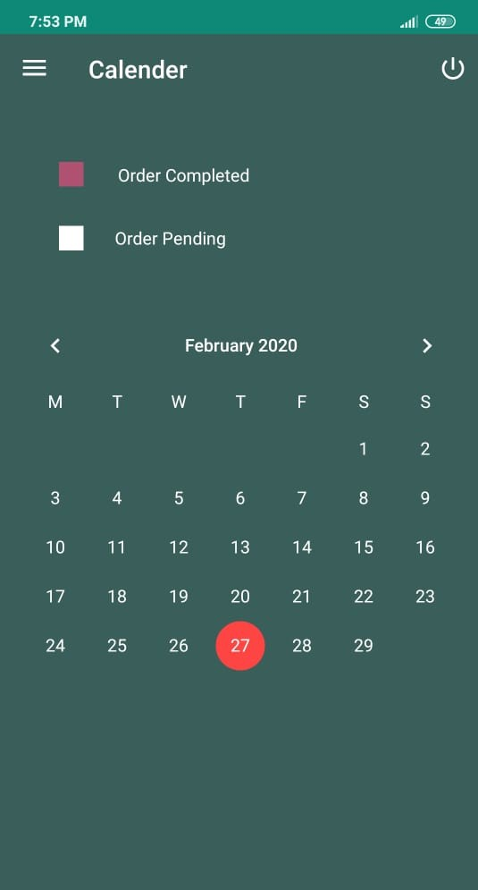
Continue…
Event Organizer Calendar Figure (9)

Slide 23
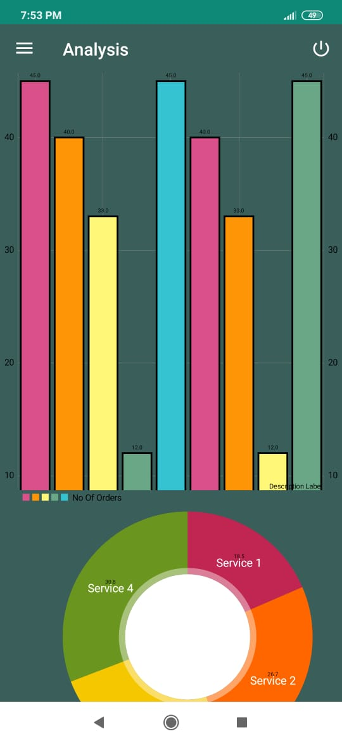
Continue…
Event Organizer Analysis Figure (10)

Slide 24
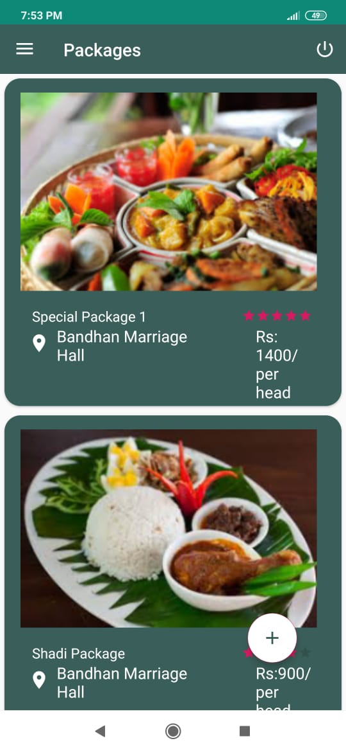
Continue…
Event Organizer Orders Figure (11)

Slide 25
Continue…
Event Organizer Packages Figure (12)

Slide 26
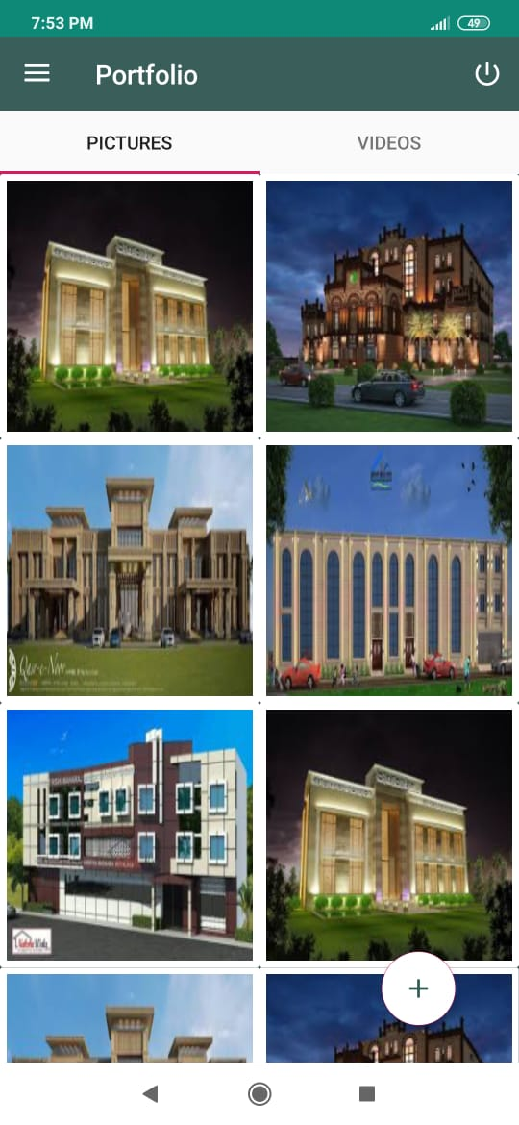
Continue…
Event Organizer Portfolio Figure (13)

Slide 27
Continue…
Client Registration Figure (14)

Slide 28
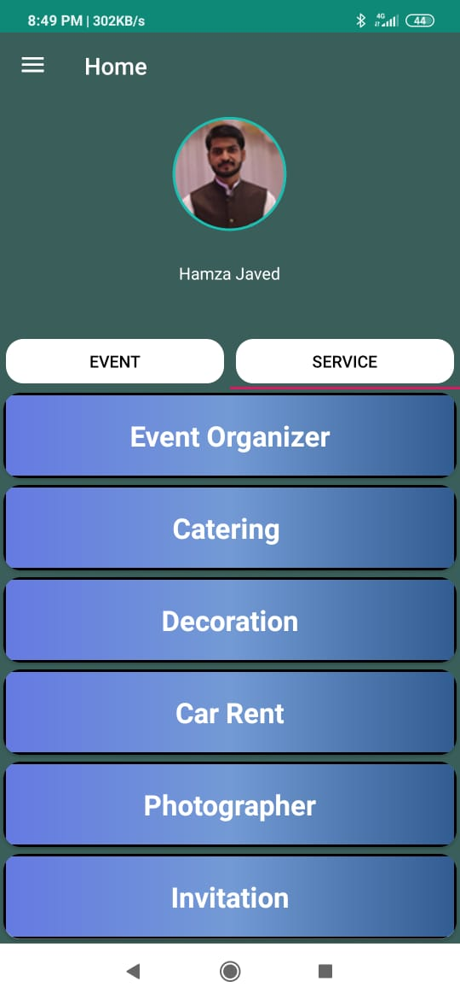
Continue…
Client Home
Figure (15)

Slide 29
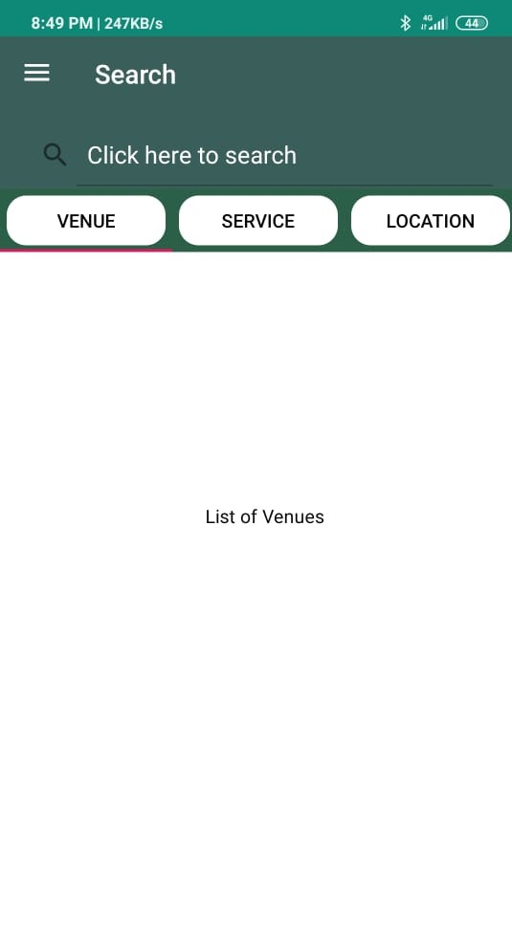
Continue…
Client Search
Figure (16)

Slide 30
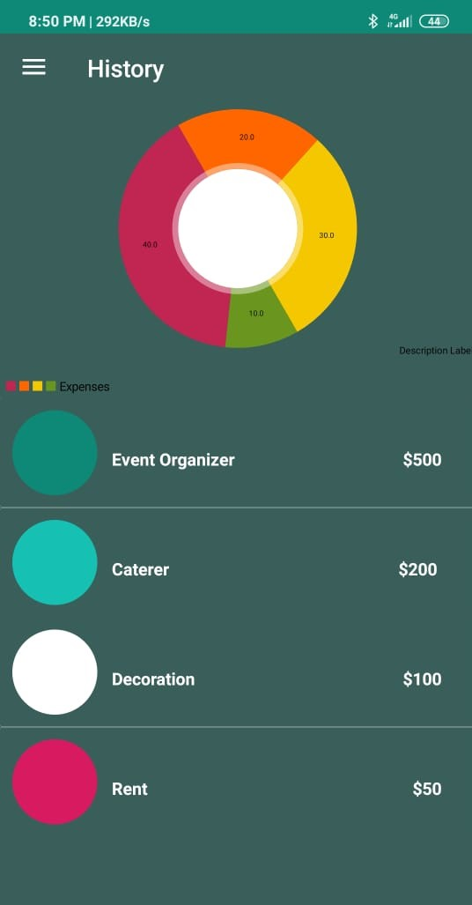
Continue…
Client History
Figure (17)

Slide 31
Continue…
Client Messages
Figure (18)

Slide 32
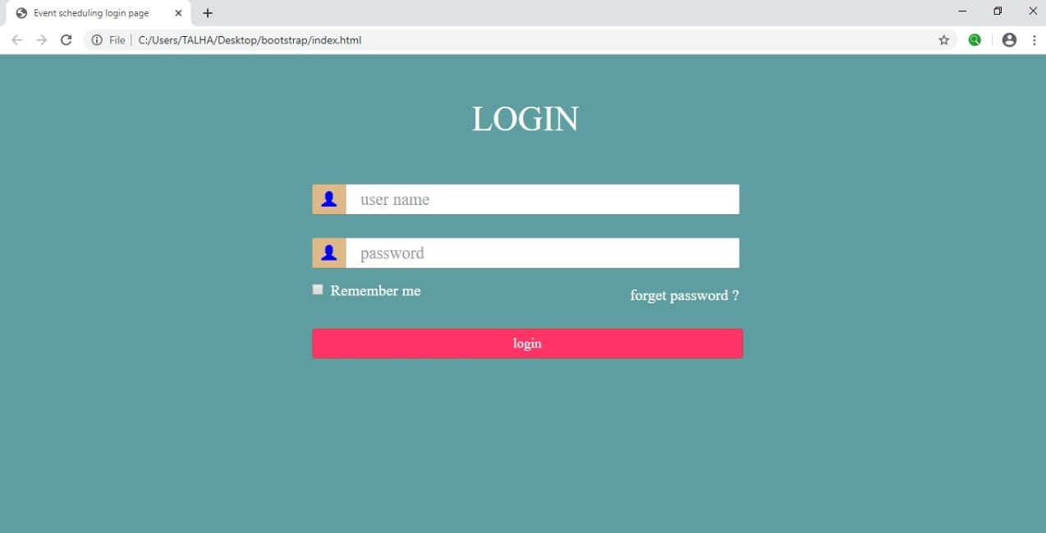
Continue…
Admin Web Panel
Figure (19)

Slide 33
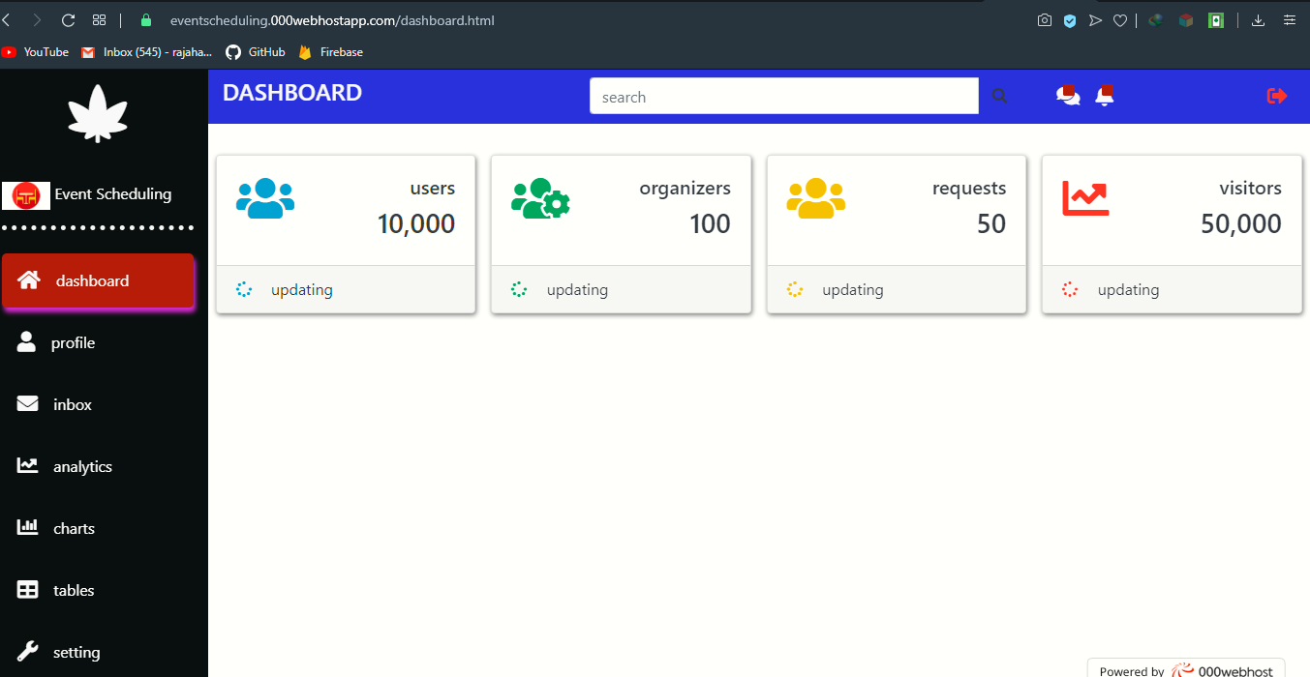
Continue…
Admin Web Panel
Figure (20)

